Slide 1

803: The Impact of AI on the Future of Archival Work
Education SessionIn-person Only
Saturday, August 17th -- 1:45 PM – 3:00 PM -- Salon C 1-4
Description:
  The panel consists of presentations that cover themes of AI and Generative AI using:
    Image Segmentation and Handwritten Text Recognition (HTR)
    Generative AI with ChatGPT
    Sociotechnical approaches for Trustworthy AI
  Richard MARCIANO:
    Prof @ U. Maryland iSchool & Director of AIC (formerly @ UNC Chapel Hill & @ UCSD Supercomputer Center)
      Anne J. GILLILAND:
        Prof @ UCLA & Director Center for Information as Evidence
  Greg JANSEN:
    Research Software Architect @ AIC / UMD & @ Advanced Research Institute for Intelligence & Security (ARLIS)
  Lori PERINE:
    Former Researcher in Trustworthy AI at the National Institute of Standards and Technology (NIST)
    See: Identifying & Managing Bias in AI & AI Risk Management Framework Playbook
      Rajesh Kumar GNANASEKARAN:
        Assistant Director of AI Solutions, Division of IT @ U. Maryland
  William UNDERWOOD:
    Research Scientist w. AIC @ UMD & (former) Georgia Tech Research Institute
    Computer Science expert in AI, NLP, ML, and Machine Vision applied to e-records and e-archives

Slide 2
Agenda: 1:45 pm – 3:00 pm (Central Time)
1:45 – 1:55 – Richard Marciano (w. Anne J. Gilliland)
  Intro AI & Archives
1:55 – 2:10 – Greg Jansen
  Techniques to Segment & Filter 1950s Census Forms
  Questions: 5 min
2:15 – 2:40 – Lori Perine (w. Rajesh K. Gnanasekaran, remote)
  Achieving Double Trust: How Can Trustworthy Computational Treatments & AI Enable Trustworthy Archives?
  Questions: 5 min
2:45 – 2:55 – Bill Underwood (remote)
  Can GPT-4 Think Computationally About Digital Archival Tasks?
  Questions: 5 min

Slide 3


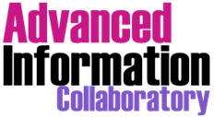


https://www.linkedin.com/in/richard-marciano/
Richard Marciano
computational-archival-science@googlegroups.com
https://ai-collaboratory.net/updates/
marciano@umd.edu

Slide 4

1. IMLS 2018-2020: CT-LASER
Developing a Computational Framework for Library and Archival Education https://ai-collaboratory.net/wp-content/uploads/2020/11/Final_Report_r.pdf
2. IMLS 2020-2024: PILOTING Network
Pilot Study with 4 iSchools & 5 Archives https://ai-collaboratory.net/projects/piloting-network/
3. IMLS 2022-2025: TALENT Network
Promoting the Training of Archival & Library Educators w. iNnovative Technologies
National implementation project. https://ai-collaboratory.net/projects/talent-network/
----------
4. IMLS 2024-2026: GenAI-4-Arch
Harnessing Generative AI to Support Exploration and Discovery in Library and Archival Collections https://www.imls.gov/grants/awarded/lg-256565-ols-24
HERITAGE-AI Initiative:
Harnessing Enhanced Research & Instructional Technologies for Archival Generative Exploration
using AI
https://heritage-ai.org/

Slide 5
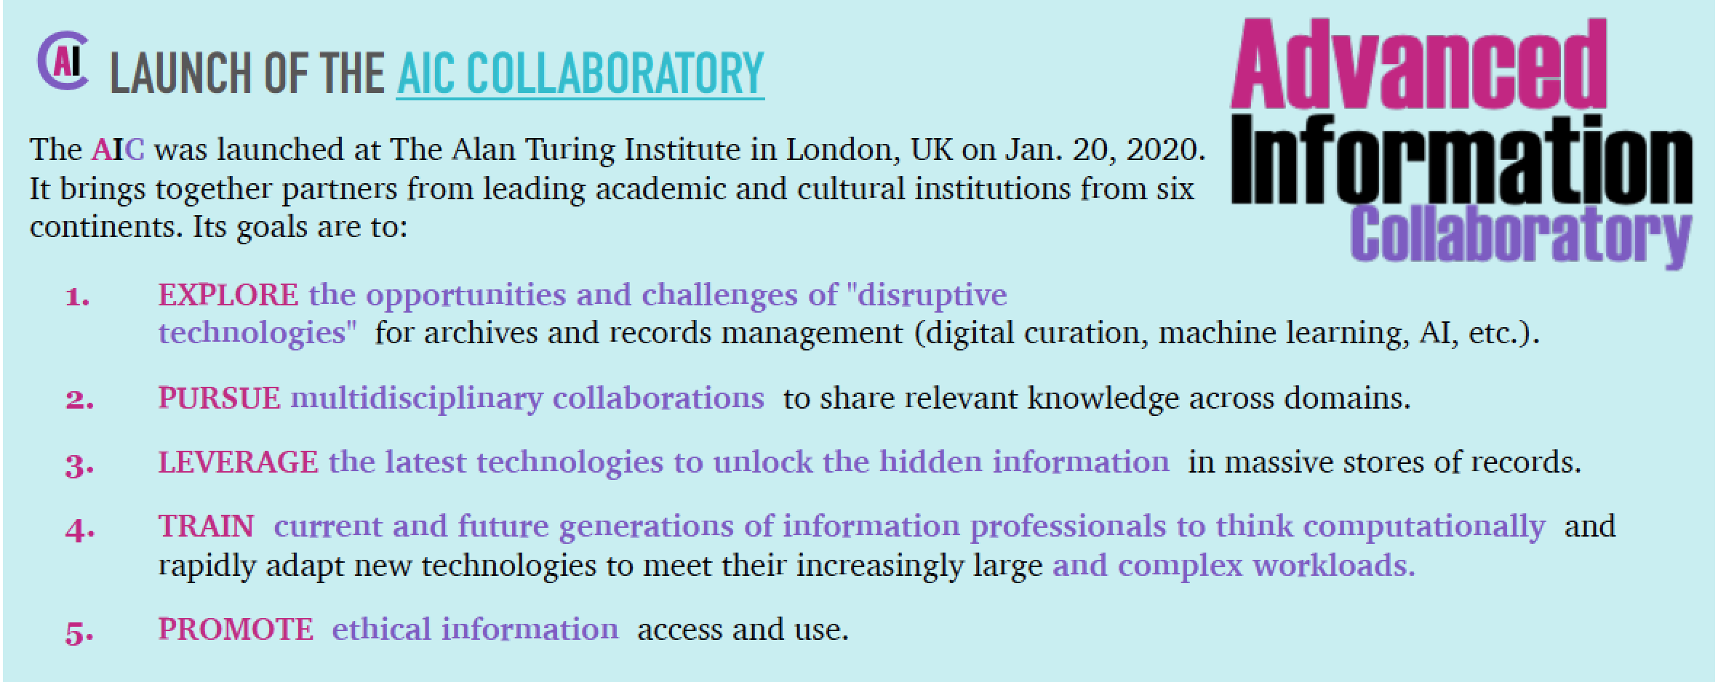
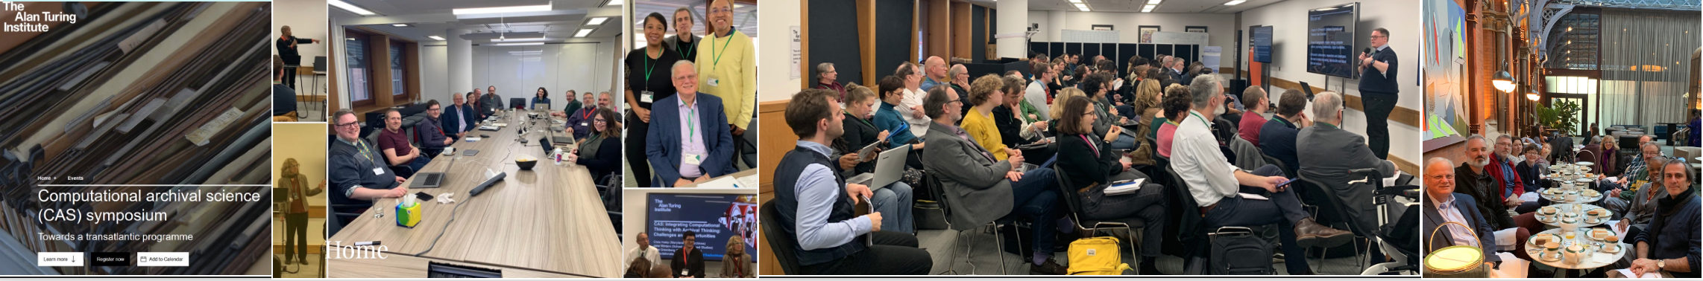

Slide 6

Computational Archival Science
(CAS)
Working Definition:
A transdisciplinary field grounded in archival, information, and computational science that is concerned with:
  the application of computational methods and resources, design patterns, sociotechnical constructs, and human-technology interaction
  to large-scale (big data) records/archives processing, analysis, storage, long-term preservation, and access problems
  with the aim of improving and optimizing efficiency, authenticity, truthfulness, provenance, productivity, computation, information structure and design, precision, and human technology interaction
  in support of acquisition, appraisal, arrangement and description, preservation, communication, transmission, analysis, and access decisions
  https://ai-collaboratory.net/cas/

Slide 7
IEEE Big Data 2017: CAS#2 Mapping Archival Concepts to Computational Methods
Archival Concepts | Computational Methods
Going from paper catalog entries to digital catalogs, Matching records in distributed databases | Graph and Probabilistic Databases
Technology assisted review accessibility of presidential and federal e-mail accessioned into National Archives | Analytics, predictive coding to address PII
Provenance in terms of why, who and how | Abstraction and ontology construction
Appraisal | File Format Characterization, File Format policies, Bulk extractor (Identifies PII), Content Preview, Tagging
Classification of archival images | AI, Line detection, image segmentation
Recordkeeping | Auto-categorization, auto-classification, e-discovery, machine learning
Personally Identifiable Information (PII) | NLP, NER, sentiment analysis
Structured data interfaces to archival materials | APIs for cultural heritage materials, graph databases
Decentralized recordkeeping | Blockchain, secure computing, trustworthiness
… | …

Slide 8
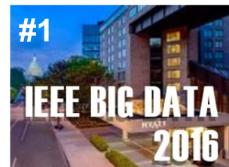
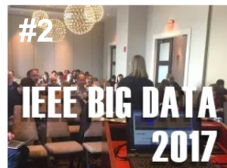
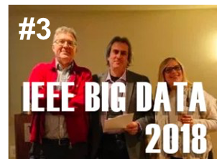
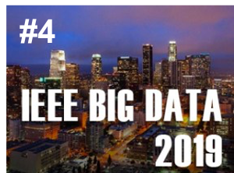
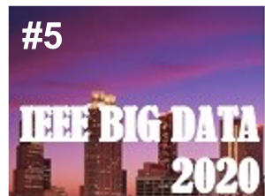
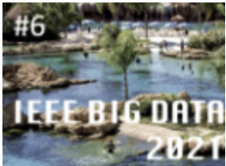
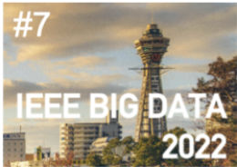
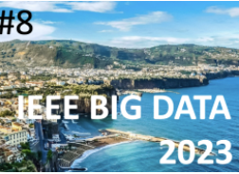
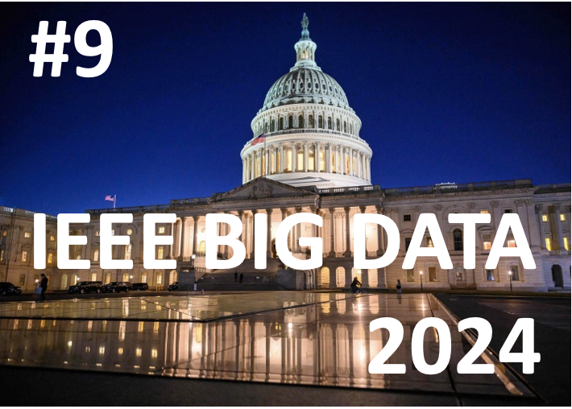
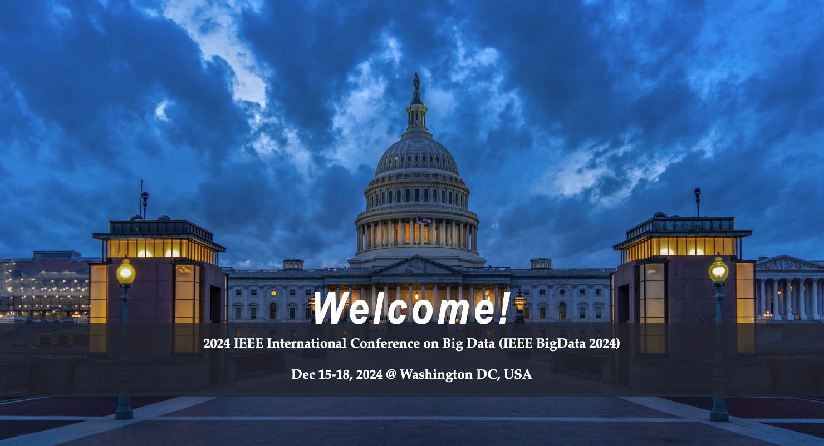
CAS PORTAL: https://ai-collaboratory.net/cas/
* Workshops:
- 50+ workshops since 2016
- 9 CAS @ IEEE Big Data Conf.
w. 150+ papers
Lessons learned from:
- CAS#1: 2016 in Washington, DC
- CAS#2: 2017 in Boston
- CAS#3: 2018 in Seattle
- CAS#4: 2019 in LA
CAS#5: 2020 in Atlanta
CAS#6: 2021 in Orlando
CAS#7: 2022 in Osaka, Japan
CAS#8: 2023 in Sorrento, Italy
CAS#9: 2024 in Washington, DC
* Presentations
* Publications
* Infrastructure
https://ai-collaboratory.net/cas/cas-workshops/2024-9th-cas-workshop/
IEEE Big Data 2024: CAS #9

Slide 9
https://ai-collaboratory.net/cas/cas-workshops/2024-9th-cas-workshop/
Monday, Nov. 4, 2024 (final): Due date for full workshop papers submission
Friday, Nov 15, 2024: Notification of paper acceptance to authors
Wednesday, Nov 20, 2024 (hard deadline): Camera-ready of accepted papers
Dec 15 to 18, 2024: Day-long CAS workshop (in person) in Washington DC, USA (exact day TBD)
RESEARCH TOPICS COVERED:
  Application of analytics to archival material, including AI, ML, text-mining, data-mining, sentiment analysis, network analysis.
  Analytics in support of archival processing, including e-discovery, identification of personal information, appraisal, arrangement and description.
  Scalable services for archives, including identification, preservation, metadata generation, integrity checking, normalization, reconciliation, linked data, entity extraction, anonymization and reduction.
  New forms of archives, including Web, social media, audiovisual archives, and blockchain.
  Cyber-infrastructures for archive-based research and for development and hosting of collections
  Big data and archival theory and practice
  Digital curation and preservation
  Crowd-sourcing and archives
  Big data and the construction of memory and identity
  Specific big data technologies (e.g. NoSQL databases) and their applications
  Corpora and reference collections of big archival data
  Linked data and archives
  Big data and provenance
  Constructing big data research objects from archives
  Legal and ethical issues in big data archives
IEEE Big Data 2024: CAS #9

Slide 10
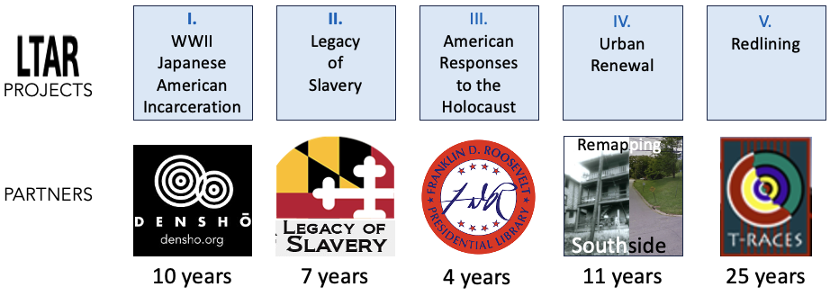
Example:
SUMMER 2024: MLIS Students Engage w. Innovative Technologies to
Explore the Future Processing of Archival Collections
through spatial, graph & genAI Techniques
https://ai-collaboratory.net/2024/07/09/summer2024/

Slide 11
SOCIAL JUSTICE, HUMAN RIGHTS, CULTURAL HERITAGE:
Upcoming Notebooks showcasing the use of AI / ML / GenAI / LLM:
Large Language Models (LLM) / ChatGPT: MSA Legacy of Slavery Project
  Conversing with the Past: Re-examining the Legacy of Slavery in Domestic Traffic Newspaper Advertisements with OpenAI's GPT3 LLM,
    Rajesh Kumar Gnanasekaran, C. E. Haley, R. Marciano, UCL PRESS: Artificial Intelligence for Cultural Heritage Organizations (2024)
Transfer Learning / BERT: MSA Legacy of Slavery Project
  Using Transfer Learning to contextually Optimize Optical Character Recognition (OCR) output and perform new Feature Extraction on a digitized cultural and historical dataset,
    Aravind Inbasekaran, Rajesh Kumar Gnanasekaran, R. Marciano, 2021 IEEE International Conference on Big Data, Dec. 15, 2021, Orlando, FL.
    See: https://ai-collaboratory.net/wp-content/uploads/2021/11/3_Inbasekaran.pdf
Digital Curation / ML: FDR Presidential Library Morgenthau Holocaust Collections Project
  Digital Curation to Support Machine Learning,
    Teddy Randby, Richard Marciano, 2020 IEEE International Conference on Big Data, Dec. 11, 2020, Atlanta, GA.
    See: https://ai-collaboratory.net/wp-content/uploads/2020/11/Randby.pdf.
Computer Vision / ML: FDR Presidential Library Morgenthau Holocaust Collections Project
  Using AI and ML to Optimize Information Discovery in Under-utilized, Holocaust-related Records,
    Kirsten Strigel Carter, Abby Gondek, William Underwod, Teddy Randby, Richard Marciano, AI & Society [Journal of Knowledge, Culture and Communication], Special issue on “Born Digital” – Shedding Light into the Darkness of Digital Culture, Fall 2021.
    See: https://ai-collaboratory.net/wp-content/uploads/2021/10/Carter-et-al-Using-AI-and-ML-to-Optimize-Information-Discovery_MHCP_AIC.pdf
Computer Vision / ML: Spelman College Archives Photograph Collection
  “An AI-Assisted Framework for Rapid Conversion of Descriptive Photo Metadata into Linked Data”,
    Jennifer Proctor, Richard Marciano, MTSR 2021 Virtual Conference, 15th International Conference on Metadata and Semantics Research, Nov. 29 – Dec. 3, 2021.
    See: https://ai-collaboratory.net/wp-content/uploads/2021/10/2021-Proctor_paper.pdf
NLP / NER: NARA War Relocation Authority (WRA)
  “Computational Curation of a Digitized Series of WWII Japanese-American Internment,”
    Underwood, B., Marciano, et al., IEEE Big Data 2017’s 2nd Computational Archival Science (CAS) Workshop, Boston, MA, Dec. 13, 2017.
    See: https://ai-collaboratory.net/wp-content/uploads/2020/04/Underwood-CAS-2017.pdf

Slide 12

AI: Considerations and Concerns for Archival Work
https://ai-collaboratory.net/updates/
Anne J. Gilliland
Department of Information Studies
University of California, Los Angeles

Slide 13
Introduction
Many different groups and interests share archivists’ concerns about AI and:
  Ethical implementation
  Privacy
  Copyright
  Deep fakes, disinformation, other forms of manipulation of facts and narratives → loss of trust, societal control
  Unconscious and/or uncontrollable bias
  Getting it wrong; hallucinations
  Impact on professions and on labor more broadly
  Environmental impact
So … archivists don’t have to work through these alone
  What, then, are distinctly archival concerns? What do archivists bring to wider efforts?

Slide 14
AI and archival work
AI is here to stay. Already widely used:
  By records creators
  By researchers using datafied digital collections
AI shows major promise for assisting archivists, e.g., in:
  Appraising, ingesting and describing massive scale digital recordkeeping systems and collections, e.g., e-communications, social media
  Managing complex digital preservation processes
  Reappraising and redescribing holdings, e.g., for reparative or reprioritization reasons
  Managing privacy, security, cultural protocols and other complex access issues
  Surfacing previously unknown/unrecognized evidence, information and affect within and across collections
  Curating archival collections for specific uses and audiences
  Presenting evidence and information in new ways

Slide 15
Some of the archival concerns arising
What, when and how is a record?
How do we ensure algorithms are getting it right? Or how much they are getting right?
  How are algorithms trained and fine-tuned?
  What is archival contextual knowledge, who has it, and why is it even more important now?
We know we can serve specific audiences and kinds of analyses better. Can we do the same for more generic audiences and research uses?
How do we ensure our records aren’t being used as proxy data for activities such as digital redlining?
Building ethical protections into tools we supply to researchers/end users

Slide 16
Essentials for the archival field: Education
Computational thinking and AI awareness have to be integrated with archival thinking
need to be trained to work in archival environmentsTechnical experts
Conceptual rigor is more important than ever – AI implementations must be archivally framed
  Archival context is paramount – it must be defined and identified
  Those involved in datafying and training and fine-tuning algorithms needs to be trained in identifying archival context

Slide 17
https://www.linkedin.com/in/richard-marciano/
Richard Marciano
computational-archival-science@googlegroups.com
https://ai-collaboratory.net/updates/
marciano@umd.edu

