Slide 1

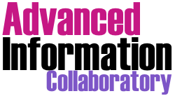

Achieving Double Trust: How Can Trustworthy Computational Treatments and AI Enable Trustworthy Archives
  Lori A. Perine
  AIC Research Fellow
  University of Maryland/INFO
  Presented to: SAA Archives*Records
  Chicago, IL
  August 17, 2024
With remote contributions by collaborator:
R.K. Gnanasekaran
INFO/UMD

Slide 2

Welcome/Today’s Presentation
Introduction
Background/Motivation
  CAS
  Lessons learned/general “trustworthy AI”
Four Case Studies
  CT-LoS: An initial exploration of opportunities and limitations
  Historic Black Lives Matter: A deeper look at data visualization
  Conversing with the Past/Learning as a Service (LaaS) Using LLMs
  Harnessing Generative AI for Exploration and Discovery: A newly launched adventure on the frontier of innovation
Questions and Answers

Slide 3

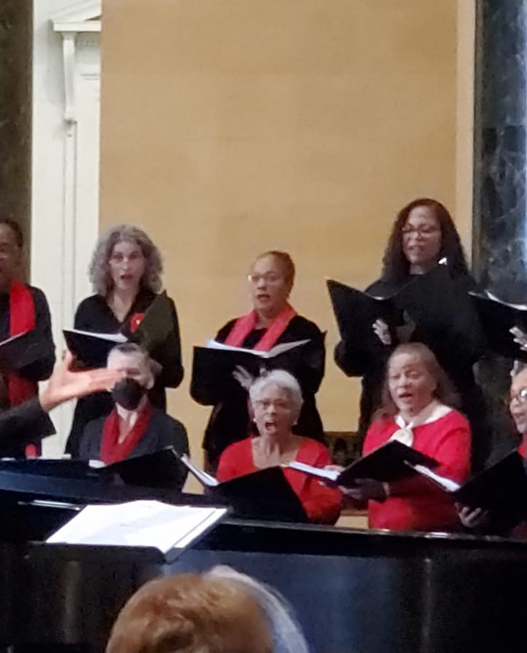
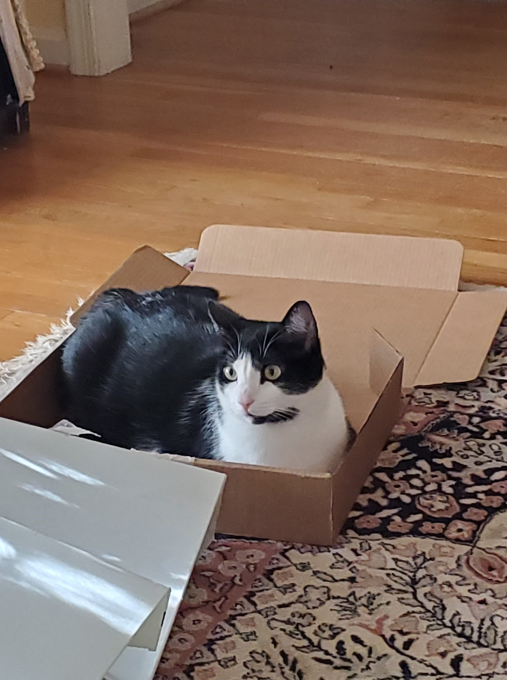

Introduction: Lori A. Perine
Current :
Research Fellow, Advance Information Collaboratory, INFO/UMD
Special Assistant, AI and Data Analytics, MIA
Former: Associate Researcher, NIST Trustworthy AI
  Research Interests:
  Responsible and Trustworthy AI
  Computational Archival Science
  Public Interest Technology
  Computational Archival Science
  International Tech Policy and Coalitions
  Faculty Affiliations: UMD, CUA, Montgomery College
  PhD candidate @ iSchool (INFO)
P

Slide 4
Background and Motivation

Slide 5
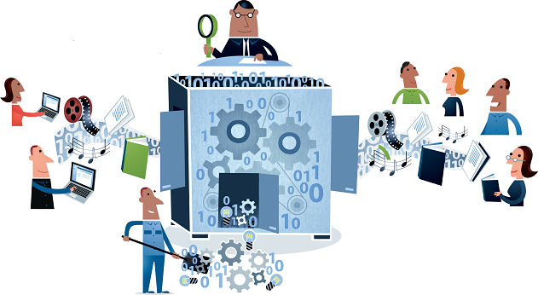
Computational Archival Science (CAS):
A Working Definition
A transdisciplinary field concerned with the application of computational methods and resources, sociotechnical constructs and human-technology interaction to large-scale:
  records/archives processing, analysis, storage, long-term preservation, and access,
with the aim of improving efficiency, productivity, and precision in support of:
  appraisal, arrangement and description, preservation, and access decisions.
https://ai-collaboratory.net/cas/
Source: Marciano et al. 2018; augmented by L.A. Perine, 2024
Illustration by Jørgen Stamp digitalbevaring.dk CC BY 2.5 Denmark
Source: Digital Preservation Handbook https://www.dpconline.org/handbook

Slide 6
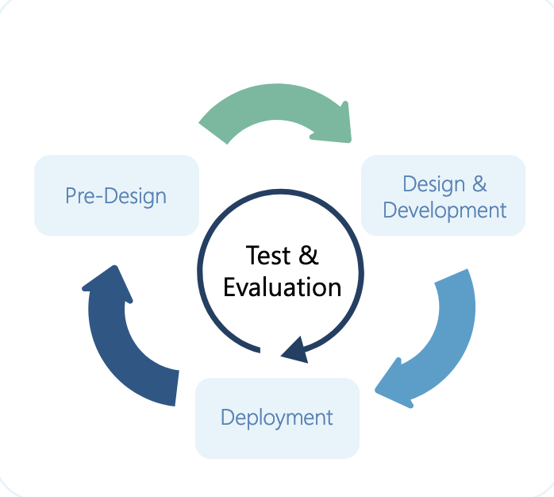
Applicable Learnings from General Trustworthy AI (1)
AI lifecycles typically track processes and ensure delivery of high-performing functional technology—but do not identify or manage harms
A sociotechnical, risk-conscious AI lifecycle places concern for people and the planet at the center of all dimensions of the lifecycle.
Source: Schwartz et al. (2022)
Source: NIST (2023) Artificial Intelligence Risk Management Framework (AI RMF 1.0)

Slide 7
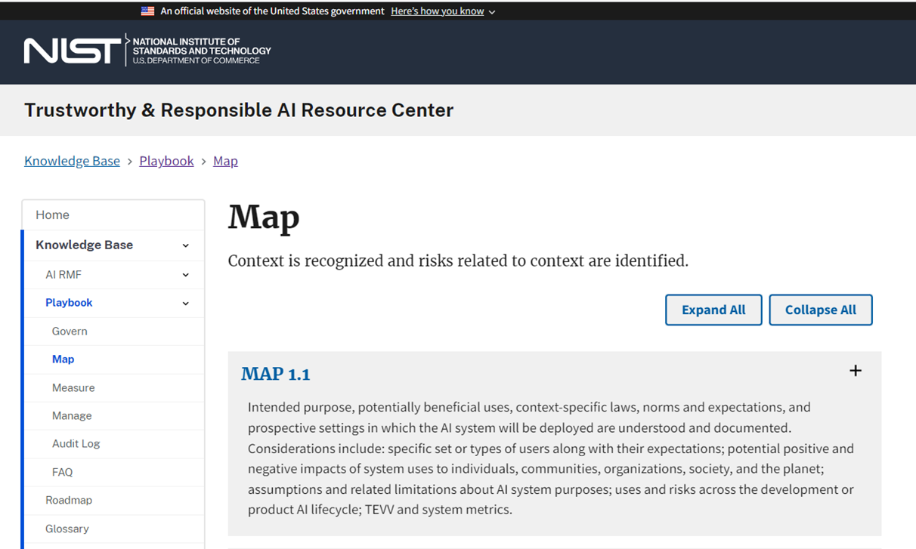
Applicable Learnings from General Trustworthy AI (2)
Socio-technical and risk conscious approaches are foundational.
  Computational/statistical methods for bias are necessary but not sufficient.
Context of application matters!
  Insight into systemic and human factors sources of bias
  Data fit-for-purpose, representativeness, and proxies
Engaging an expanded ecosystems of stakeholders is key.
  Essential for modeling and impact assessment
  More transparent power and decision-making dynamics

Slide 8
CAS in Practice
Computational Thinking
Data Analytic Practices
Archives Practice
Illustration by Jørgen Stamp digitalbevaring.dk CC BY 2.5 Denmark
Source: Digital Preservation Handbook https://www.dpconline.org/handbook

Slide 9
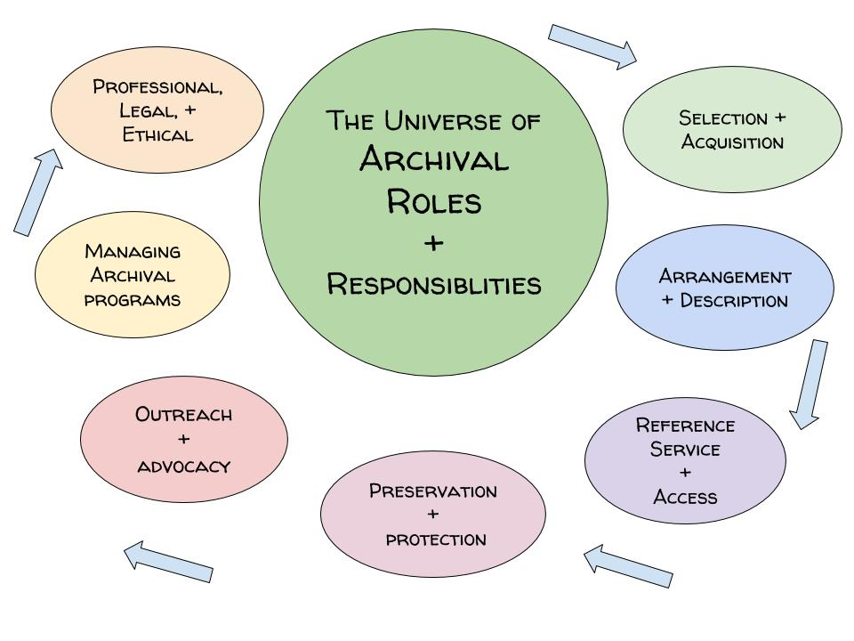
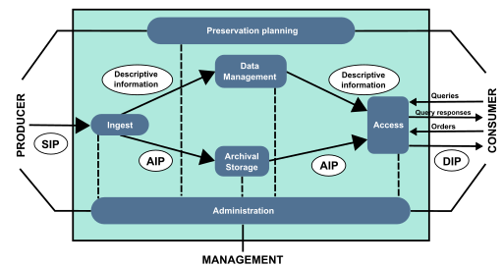
Application Domain:
Open Archival Information System (OAIS)
Mathieualexhache (original work); Mess (SVG conversion & English translation)
CC BY-SA 4.0 <https://creativecommons.org/licenses/by-sa/4.0>, via Wikimedia Commons

Slide 10
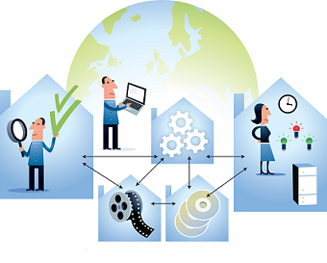
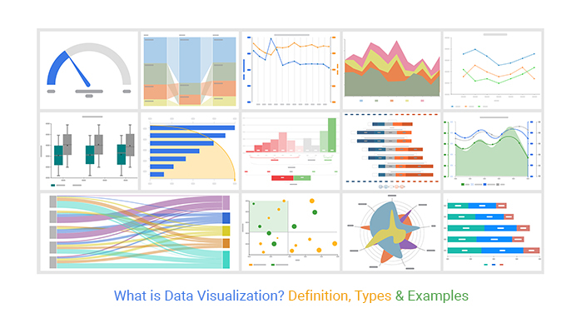





Generic Data Science Workflow
Data Sourcing
Data Mining
Data Cleaning
Data Filtering and Extraction
Exploratory Analytics &
Visualization
Modeling & Simulation
Illustration by Jørgen Stamp digitalbevaring.dk CC BY 2.5 Denmark
Images: Data Entry Export and Chart Expo

Slide 11
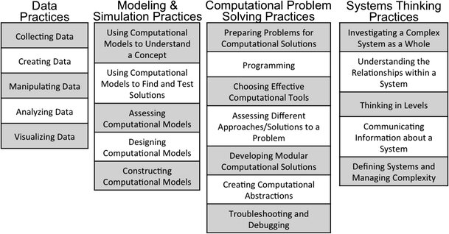
Computational Thinking Taxonomy
Adapted to the fundamental concepts and techniques specified by SAA guidelines for a GPAS Curriculum (Underwood et al, 2018 and 2019)
Provides scaffolding for research design and decisions involving computational treatments
Allows re-framing of systems thinking to incorporate socio-technical considerations and human-centered approaches
Sources: Weintrop, Beheshti, et al (2016); Underwood, Weintrop, et al. (2018); Underwood and Mariciano (2019).

Slide 12
Focuses of today’s presentation:
- sociotechnical to enable trustworthiness
- applications for access/ consumer/end-user
Computational processing and AI are being used in the digital humanities and STEM fields to collate, cross-compile and analyze digitized and born-digital archival materials in new ways in order to gain new insights
Prepare digital archival content for end-user computational processing, e.g.,
  by ensuring archival content can be compiled, manipulated and curated at a very granular level
  by adding descriptive metadata that supports new kinds of disciplinary research questions

Slide 13

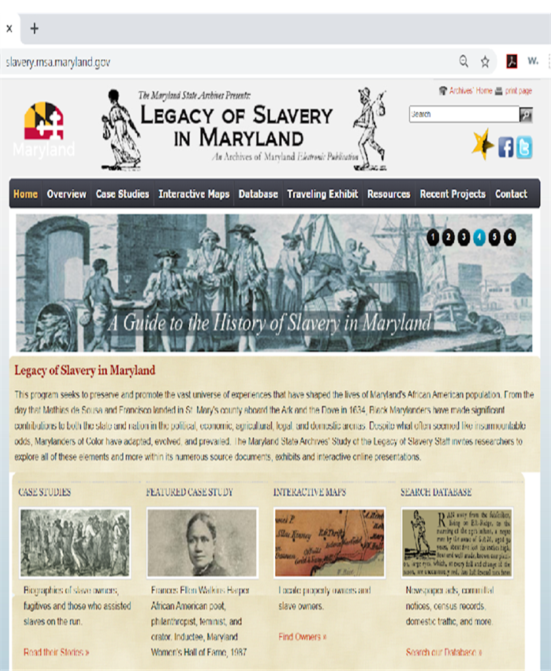
Case Studies with MSA Legacy of Slavery Collection: FromFoundational to Targeted Exploration
Foundational CT explorations
Specialized CT application
Gen AI Technical exploration
Stakeholder participation and gen AI

Slide 14
Case Study 1:
Computational Treatments to Recover Erased Heritage: A Legacy of Slavery Case Study (CT-LoS)
An initial exploration of opportunities and limitations

Slide 15

CT-LoS Project Overview
Research Methodology: Exploratory case-study organized around use of primarily open source data analytics tools and methods applied to two datasets from the MSA collections. Dissemination via peer-reviewed paper, presentations, and Jupyter notebooks.
Interdisciplinary research presented and published for IEEE Big Data 2020, CAS Workshop #5
Explore application of computational methods to enhance discovery of histories of marginalized communities .
Adopt computational thinking for case study conceptualization and implementation
Address socio-technical context in application of computational treatments.
Demonstrate experiential, interdisciplinary, team-based learning for information professionals
Create learning/teaching artifacts
UMD Collaborators: Dr. Richard Marciano, R.K. Gnanasekaran, P. Nicholas, A. HIll
Community Partner/Collaborator:
  Maryland State Archives
  Legacy of Slavery Program
Research Questions | Research Methods
(RQ1) What are the opportunities and limitations for using computational methods and open source tools to characterize data encoded within records of enslavement and to discover new patterns and relationships in that data? | Apply computational methods associated with “big data” to information contained within text-based records of archival collections related to slavery.
(RQ2) How does knowledge of social and cultural systems impact those opportunities and limitations? | Investigate the socio-cultural context in which the original source artifacts and were created and collected; and second, the socio-technical context for converting those artifacts into digital formats.

Slide 16
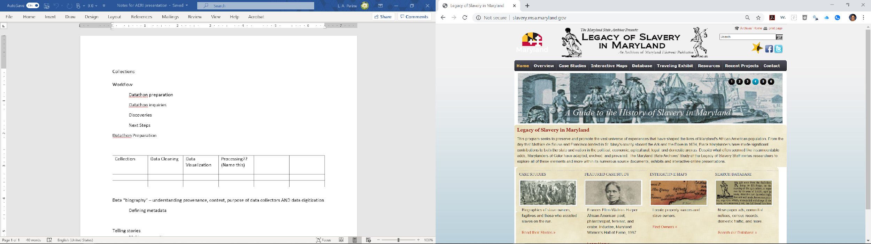
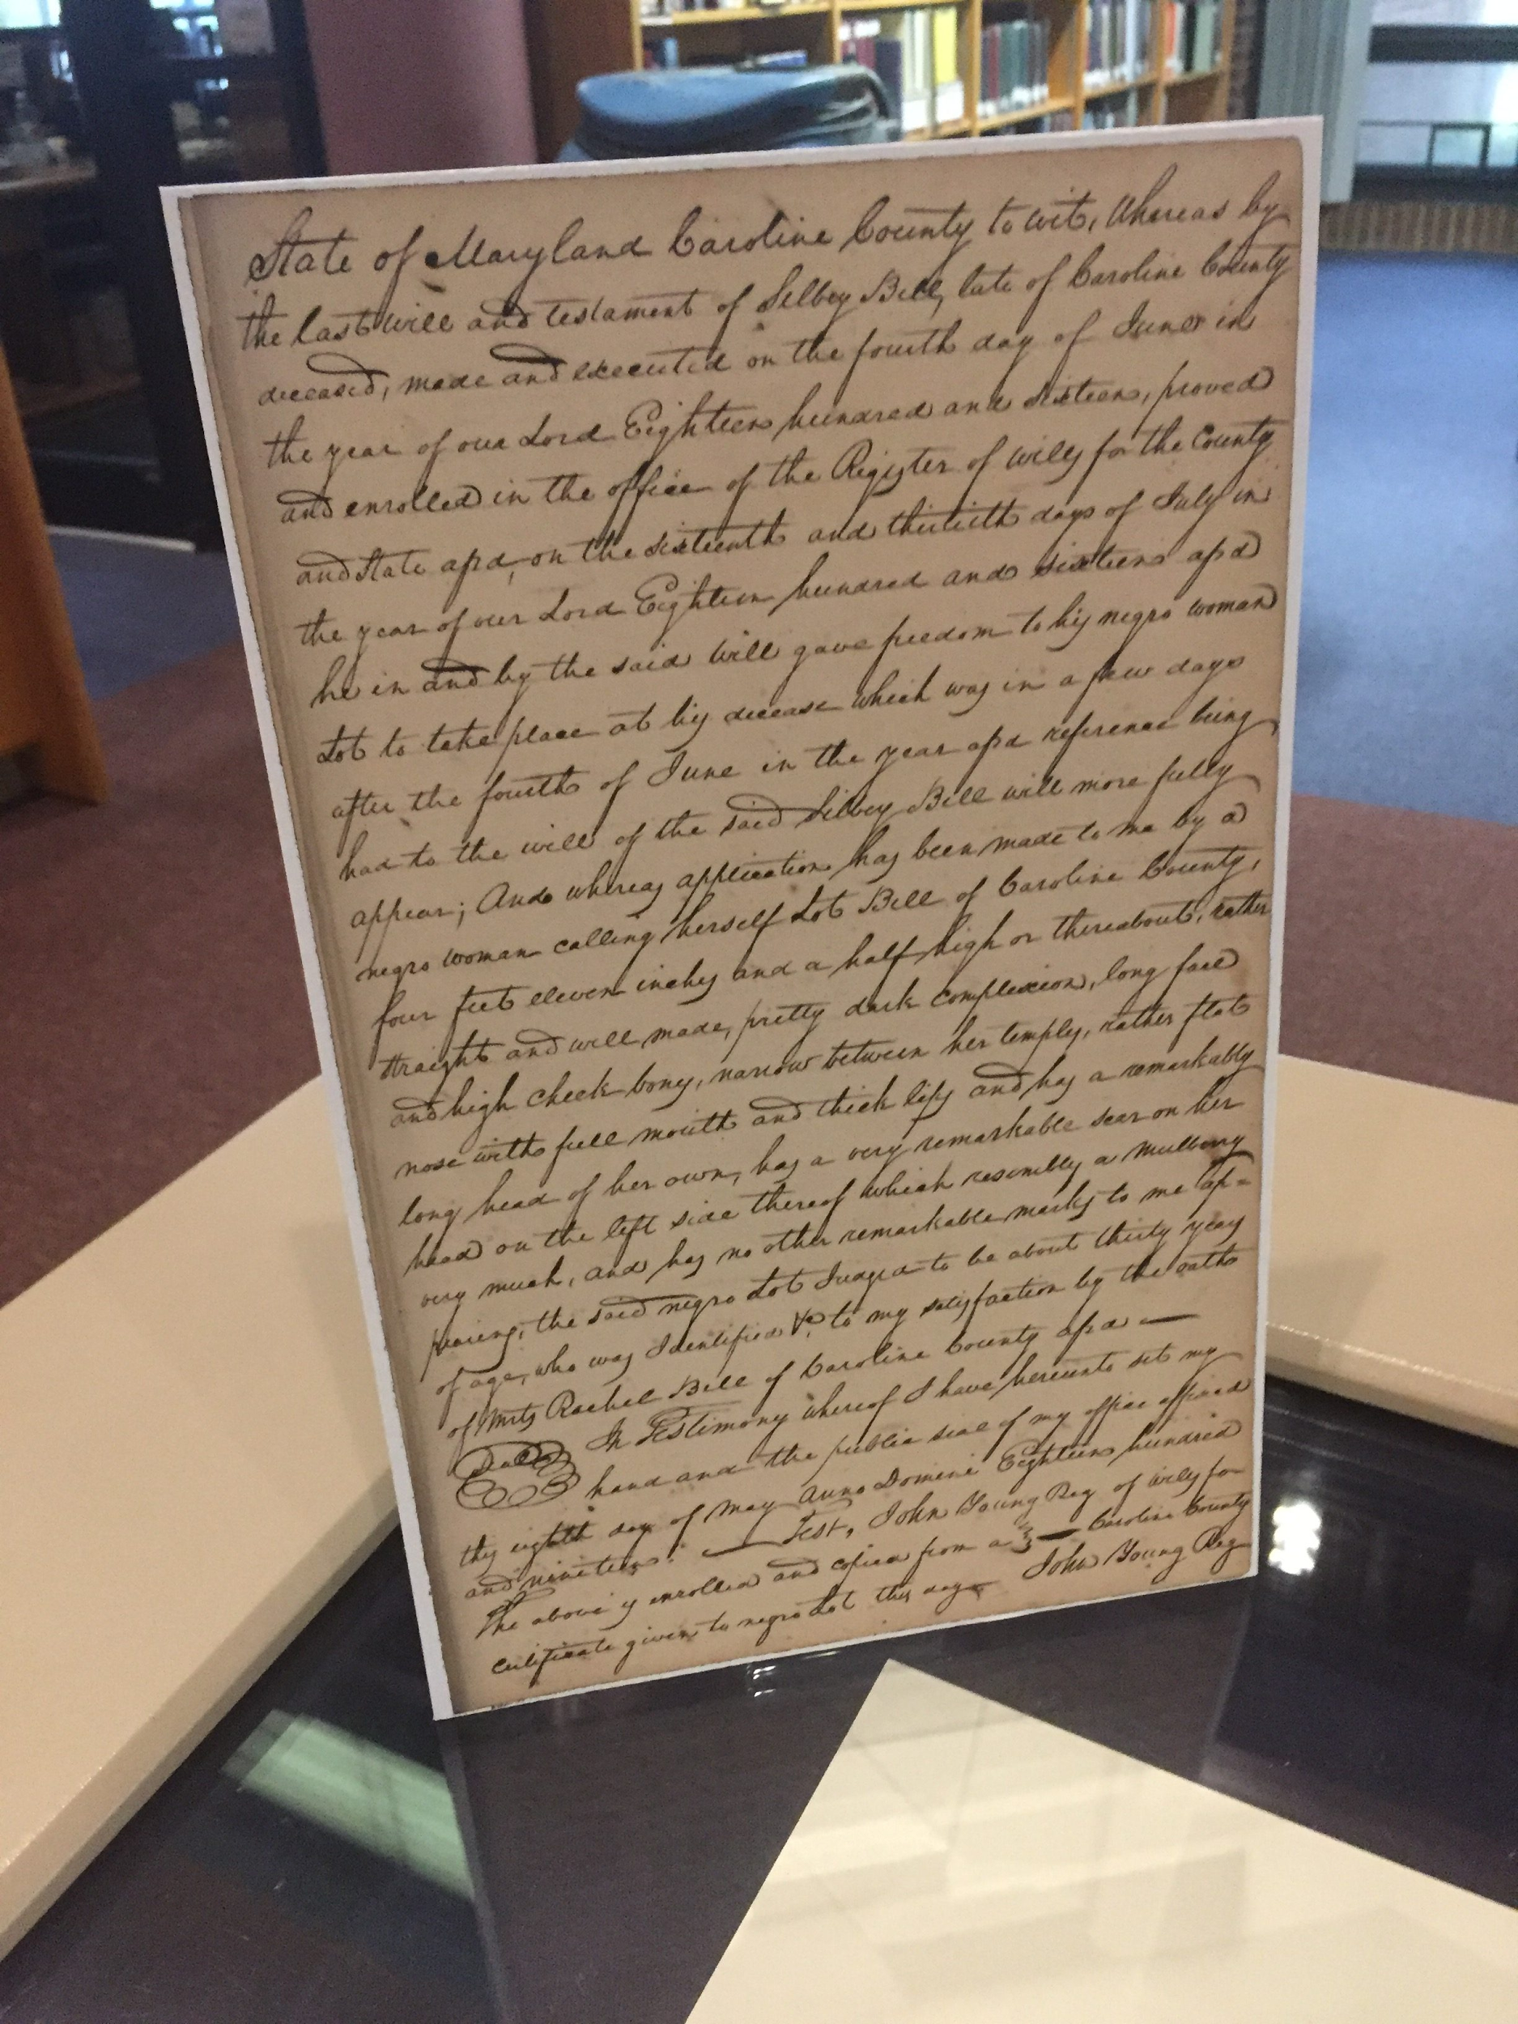
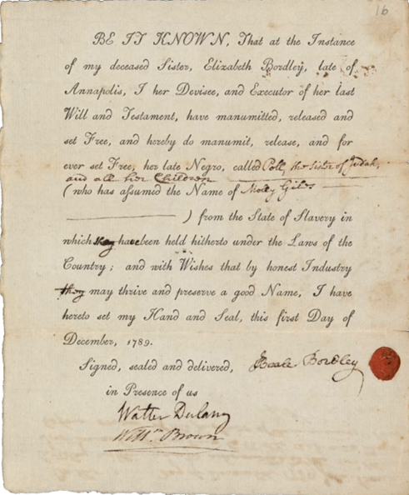
Data Sourcing: Freedom Records from the MSA
Certificate of Freedom:
Manumissions Documents

Slide 17
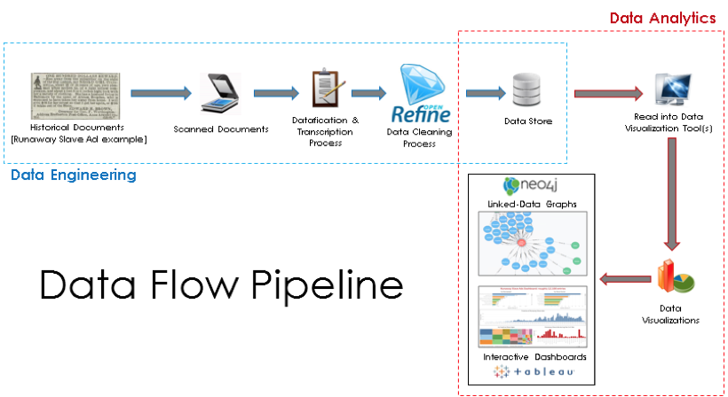


CT-LoS Scope in Work Flow

Slide 18
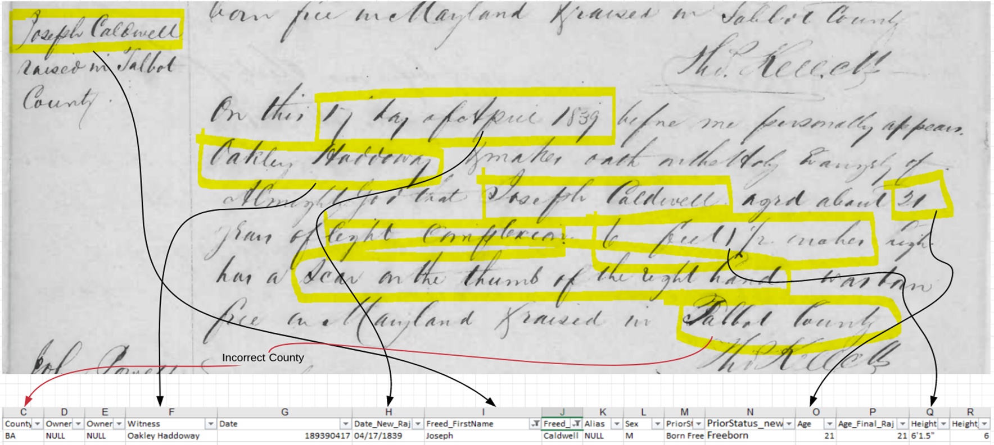
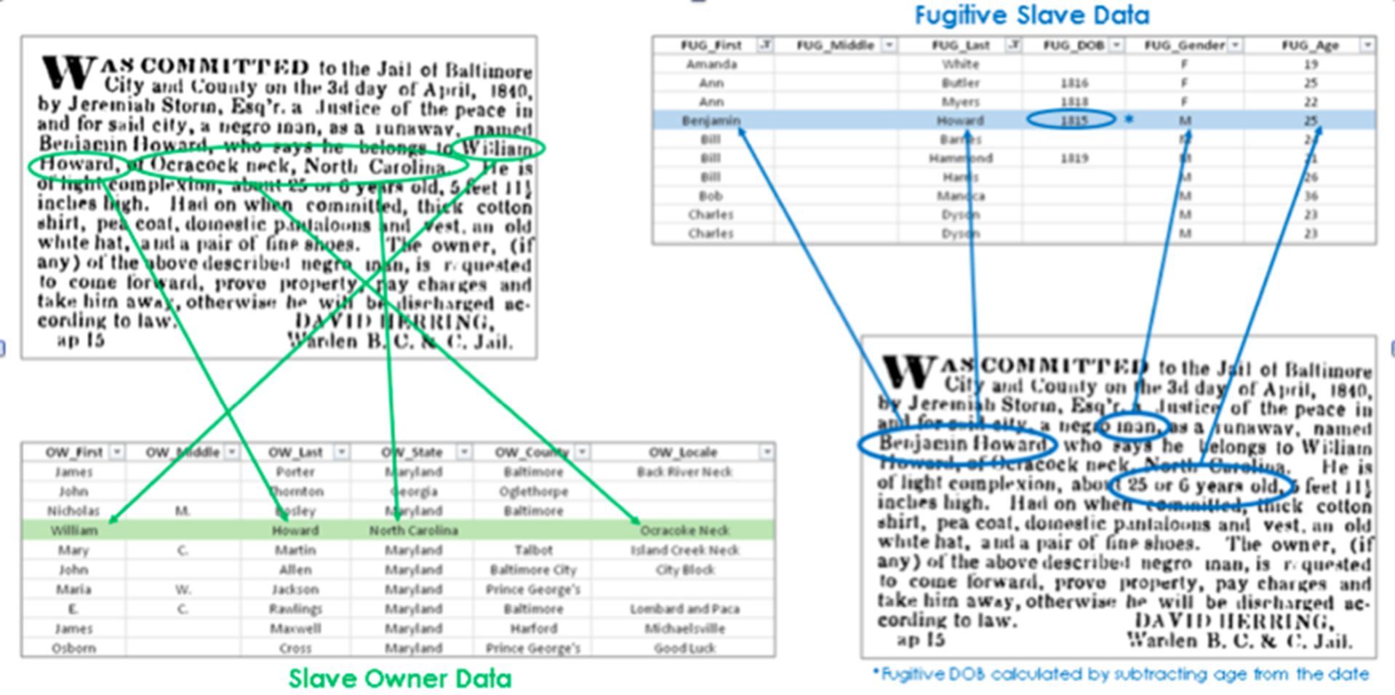

Data Sourcing Considerations for Computational Explorationn
Relational SQL databases created from original source documents
  Non-standard primary sources
  Transcription errors
  Data entry errors
Limitations of two dimensional technical tools
Assumptions regarding definitions of data fields and what/how to “mine” from original documents
How well are meaning and relationships captured by the digitized representations? What data elements are lost or ignored? Why? Who decides???
The sociotechnical context for datification of the original sources is an important element in assessing trustworthiness of the data exploration.

Slide 19
Data “Biography”: Key sociotechnical consideration for applying computational methods
Application of computational thinking invites us to examine how socio-technical context informs the potential for extending metadata and methods: when, what, who, why, how, where
  Original documents
  Assumptions and technology for the digitization and datification processes
  Computational exploration, visualization, and linking
We need to do this in all phases of the workflow:
    data preparation – abstraction as metadata?
    data wrangling – decisions for addressing non-standard, transcription, possible duplicates, missing information
    data analysis and visualization – transparency, explainability, and interpretation
Notes:
What is explicitly and implicitly contained in the data? How is it represented --- which tools or techniques can be applied.

Slide 20
Data “Biography” Influences Computational Decisions
 | Original Documents | Digitization and Datafication | Computational Exploration
Provenance | X | X | X
Legal Context | X |  | X
Historical Context | X | X | X
Geographic Context | X |  | X
Transcription/ Translation |  | X | X
Technology Tools and Methods |  | X | X
when, what, who, why, how, where
Notes:
Top level view – examples of data “biographical” features and their relevance for influencing computational decisions

Slide 21
Basic Descriptive Analytics Provides Insights/Discovery for Intepretation (1)
Number of Records: 7,399 initial cleaned
Geographic Coverage: 10 of 24 counties
Year Issue: 1770-1870
(delayed manumissions)
Age Range: 0 (infant) – 80
(original max = 237)
Male: 47.9%
Female: 51.7%
Unknown: 523
Certificates of Freedom
Manumissions
Number of Records: 23,655
*Possible Duplicate Records
Geographic Coverage: 16 counties & 1 city
Year Issue: 1806-1864
Age Range: 3 months-82 years old
Male: 93% (21,887)
Female: 5% (1,082)
Unknown: 2% (686)

Slide 22
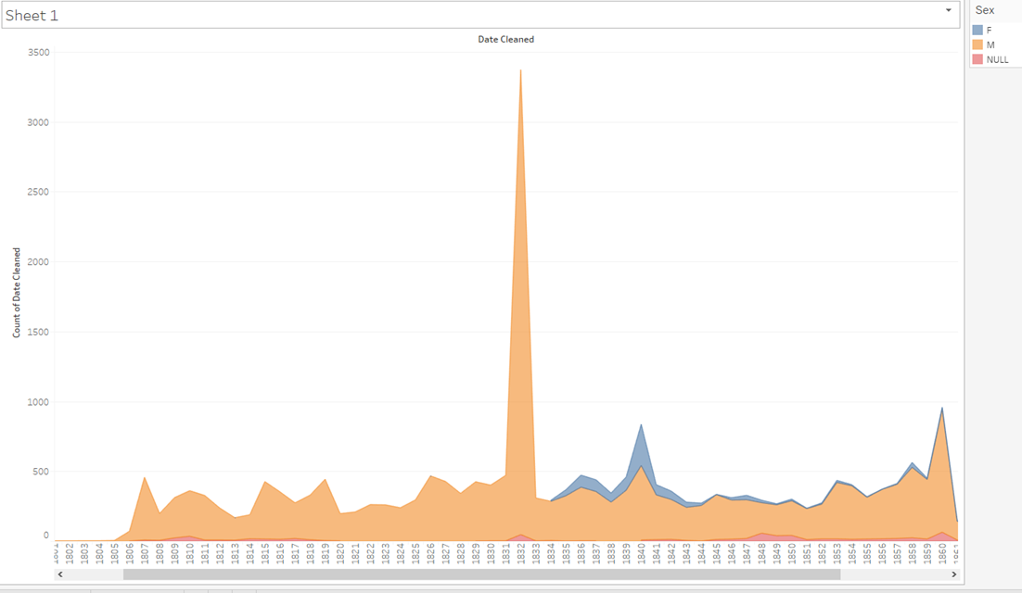
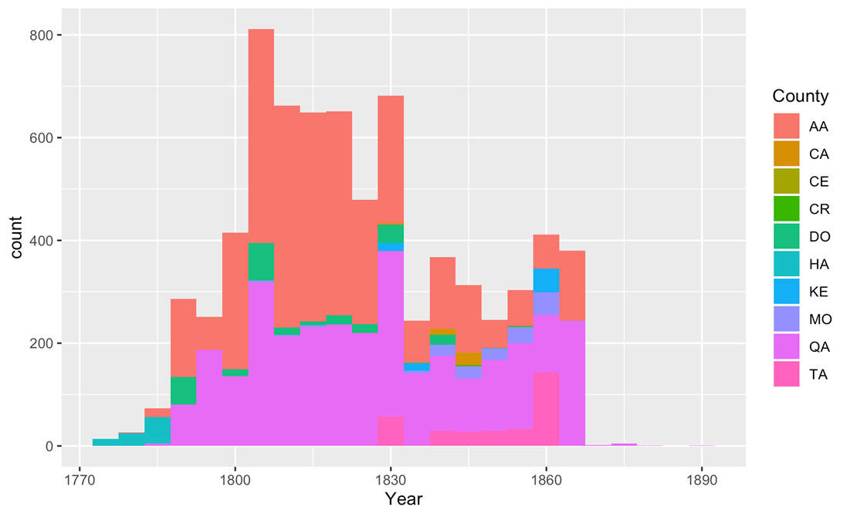
Basic Descriptive Analytics Provides Insights/Discovery for Intepretation (2)
What happened around 1831/32?

Slide 23

LoS Data Biography: Maryland Historical Context
1642- The first cargo ship with 13 Africans arrives in St. Mary's City. The legal status of indentured servants and slaves in Maryland remains in contention.
1664- Maryland legalizes slavery.
1775- The Revolutionary War begins.
1783- Maryland prohibits the importation of slaves.
1783- The Maryland Gazette published "Vox Africanorum", an editorial denouncing the inequality in the newly formed America, which promoted liberty and freedom while enslaving thousands.
1796- The Maryland General Assembly liberalizes the state's manumission laws regarding how and when a slave owner can free his/her slaves.
1831- The Maryland Colonizational Society forms to colonize Maryland blacks in Africa.
1832- In response to the Nat Turner Revolt, Maryland's legislature prohibits free blacks from entering the state.
1857- The U.S. Supreme Court hands down the Dred Scott decision, which denied African Americans equal rights as citizens.
1860- The Maryland General Assembly outlaws manumission by deed or will.
1861- The Civil War begins.
1862- Slavery is abolished in District of Columbia.
1863- Lincoln issues the Emancipation Proclamation, which frees all slaves in the territories currently in rebellion.
1864- On November 1, slavery is abolished in Maryland.
1865- Slavery is abolished in all of the states by the 13th Amendment.

Slide 24
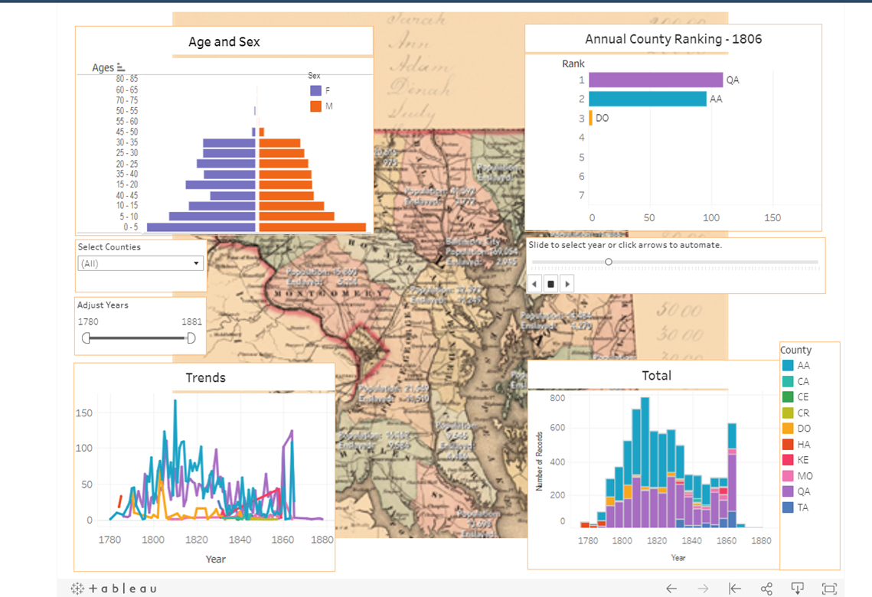
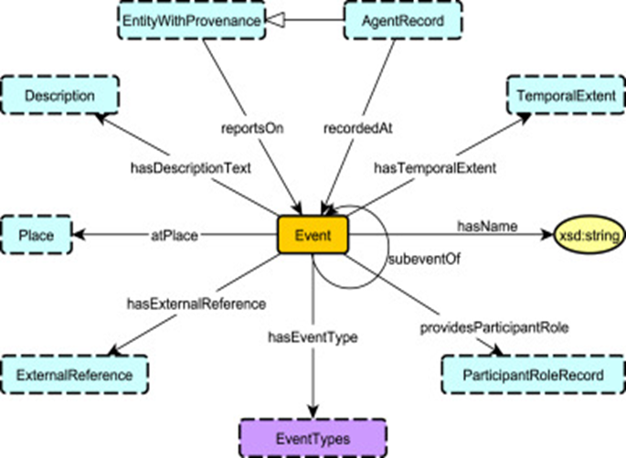
Research Topics Proposed at the Time
Interactive visualization with existing data sets
Textual data-mining with existing data sets
Graph database and cross-collection connections
Adapt ontology for enslaved populations for better representation of actors, relationships, and events
Metadata extensions or “retrofits” to enable connections across collections
Probability models and machine learning to automate connection discovery
Graph Image Source: Shimizu, C. et al, The enslaved ontology: Peoples of the historic slave trade. Journal of Web Semantics, Vol. 63, August 2020. https://doi.org/10.1016/j.websem.2020.100567
Notes:
Knowledge of legal, historical, geographical context had implications for selecting tools and methods, and interpreting the results.
Not easy to access data rich information placed in notes fields by transcribers
Limited capacity for cross collection exploration
Able to produce meaningful summaries and visualization to view historical record through different lens
Patterns in the data provide new insights into effects of historical events.

Slide 25
Case Study 2:
Historical Black Lives Matter
A deeper look at data visualization

Slide 26
HBLM Design Overview
Research Methodology: Data visualization design and case study. Dissemination via public web-based interactive data visualization and published blog on the VisUMD site via Medium.
Extension of the CT-LoS research, focusing on the manumissions data
Create a series of web-based visualizations to enhance the MSA’s interactive offerings, which target educators and researchers
Explore how design principles and interactive and/or dynamic implementation can enhance user engagement with collections.
Create learning/teaching artifacts
Community Partner:
  Maryland State Archives
  Legacy of Slavery Program
Design Objectives | Design Methods
(OBJ1) Ensure representation of the human beings encoded within the data | Multiple interactive interfaces to vary perspective of data engagement. Uniform color coding, element layout, and use of dynamic and interactive elements.
(OBJ2) Provide an interface that allows users to easily engage with the data | Beta testing and user evaluation
(OBJ 3) Facilitate discovery and communication of information contained in the collections, while taking into account the limitations of the data. | Selective use of design elements and interactive interfaces to represent 1)people, 2)Time and place, 3) geography, and overview.

Slide 27
Data Sourcing: Freedom Records from the MSA
Certificate of Freedom:
Manumissions Documents

Slide 28
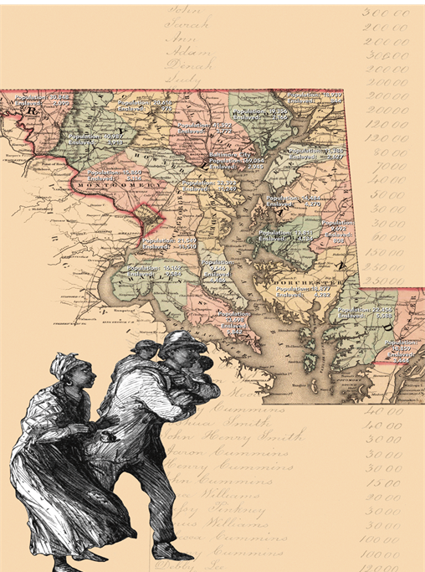
Viz Design Challenges
Text, text, text!
Non-standard information
Representation of human beings
Engage and Communicate
Ideal design vs. technical capability

Slide 29
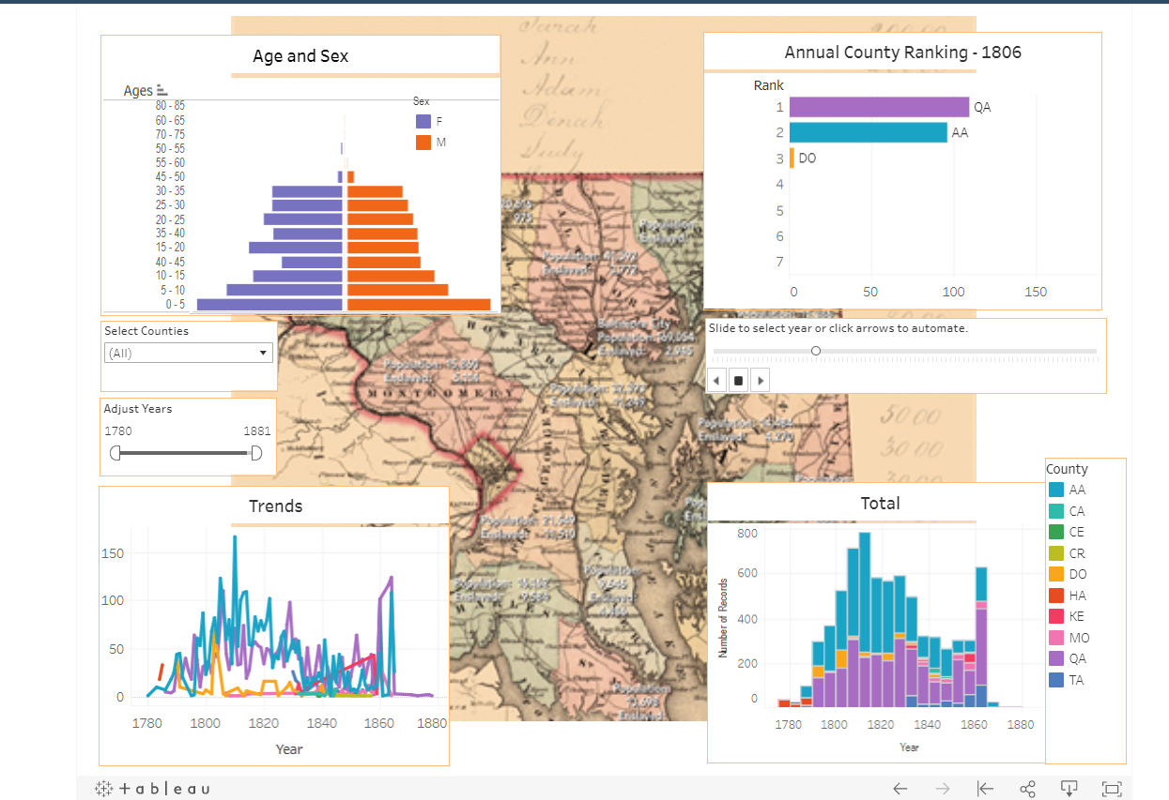
Viz Demonstration – Tableau Dashboard
https://public.tableau.com/app/profile/l.a.perine/viz/ManuVizPresentation/ManumissionsintheStateofMaryland1774-1874

Slide 30
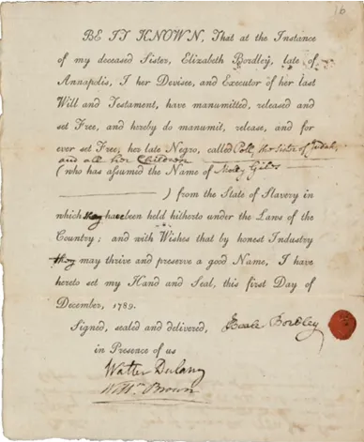
Key Takeaways
Dynamic and interactive elements help to engage interest and tell a story
Position of elements aids interaction and engagement
Variety in elements supports investigation
Similar information presented with different marks and interactivity can support broader communication
Static elements and background provide context/reference points
Color palette is important – colorblind user feedback
Fewer elements + high interactive = interest + usability
L. Perine. (Dec. 2020). Historic Black Lives Matter: Visualizing Hidden Heritage in Legacy of Slavery Collections. [Blog] VisUMD: Visualization at University of Maryland, Available at: https://medium.com/visumd/historic-black-lives-matter-visualizing-hidden-heritage-in-legacy-of-slavery-collections-23d3266dd0c5

Slide 31
Case Study 3:
Leveraging Cloud-based OpenAI’s LLMs to Create Learning-as-a-Service (LaaS) Solutions for Culturally Rich Conversational AI: A Study Using the Legacy of Slavery Dataset
Applying emerging computational technology: LLM
Research by Rajesh Kumar Gnanasekaran, AIC Fellow, Doctoral Candidate

Slide 32
LaaS-GPT Project Overview
Research Methodology: Exploratory case-study using of primarily opensource data analytics tools and methods applied to DTA dataset from the MSA collections. Dissemination via Jupyter notebooks, peer-reviewed paper, presentations.
Need for increased support to learn/teach programming and to use Computational Thinking practices in the Archives and Library Sciences field via open source methods
Create unique LaaS solutions in the form of cloud-hosted, coherent and modularized digital notebooks that could be publicly accessed
Serve as self-teaching material for interested individuals on advanced computational thinking topics in a simple manner
Use culturally rich dataset collections as case studies in these LaaS solutions. Adds a third benefit by enabling access to these datasets for research and analysis by the budding students and researchers Create learning/teaching artifacts
UMD Team: R.K. Gnanasekaran, Dr. Richard Marciano,
Community Partner/Collaborator: C.E. Haley,
  Maryland State Archives
  Legacy of Slavery Program
Research Questions | Research Methods
(RQ1) What are the potential benefits and challenges associated with utilizing Large Language Models, such as OpenAI’s GPT models, to develop a tailored chatbot capable of exploring data from high cultural context datasets and unveiling previously undiscovered relationships and patterns within this data? | Learn/Teach Python to create AI/chatbots and to perform data science on culturally rich datasets. Tools: Python, Jupyter Notebooks, Chat GPT, Tableau
(RQ2) How can we compare GPT models with traditional, non-AI exploratory data analysis models? | Perform aggregate data analysis via chatbot and compare with open source data analysis via Tableau Tools: LangChain and Tableau

Slide 33
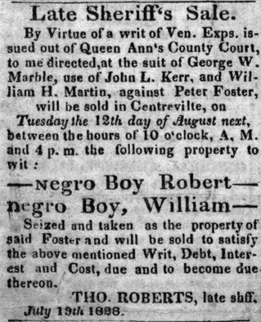
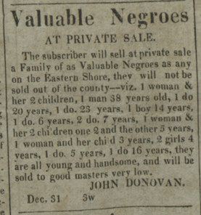
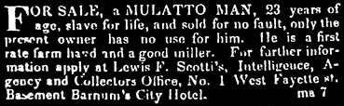
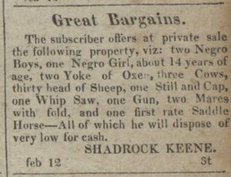
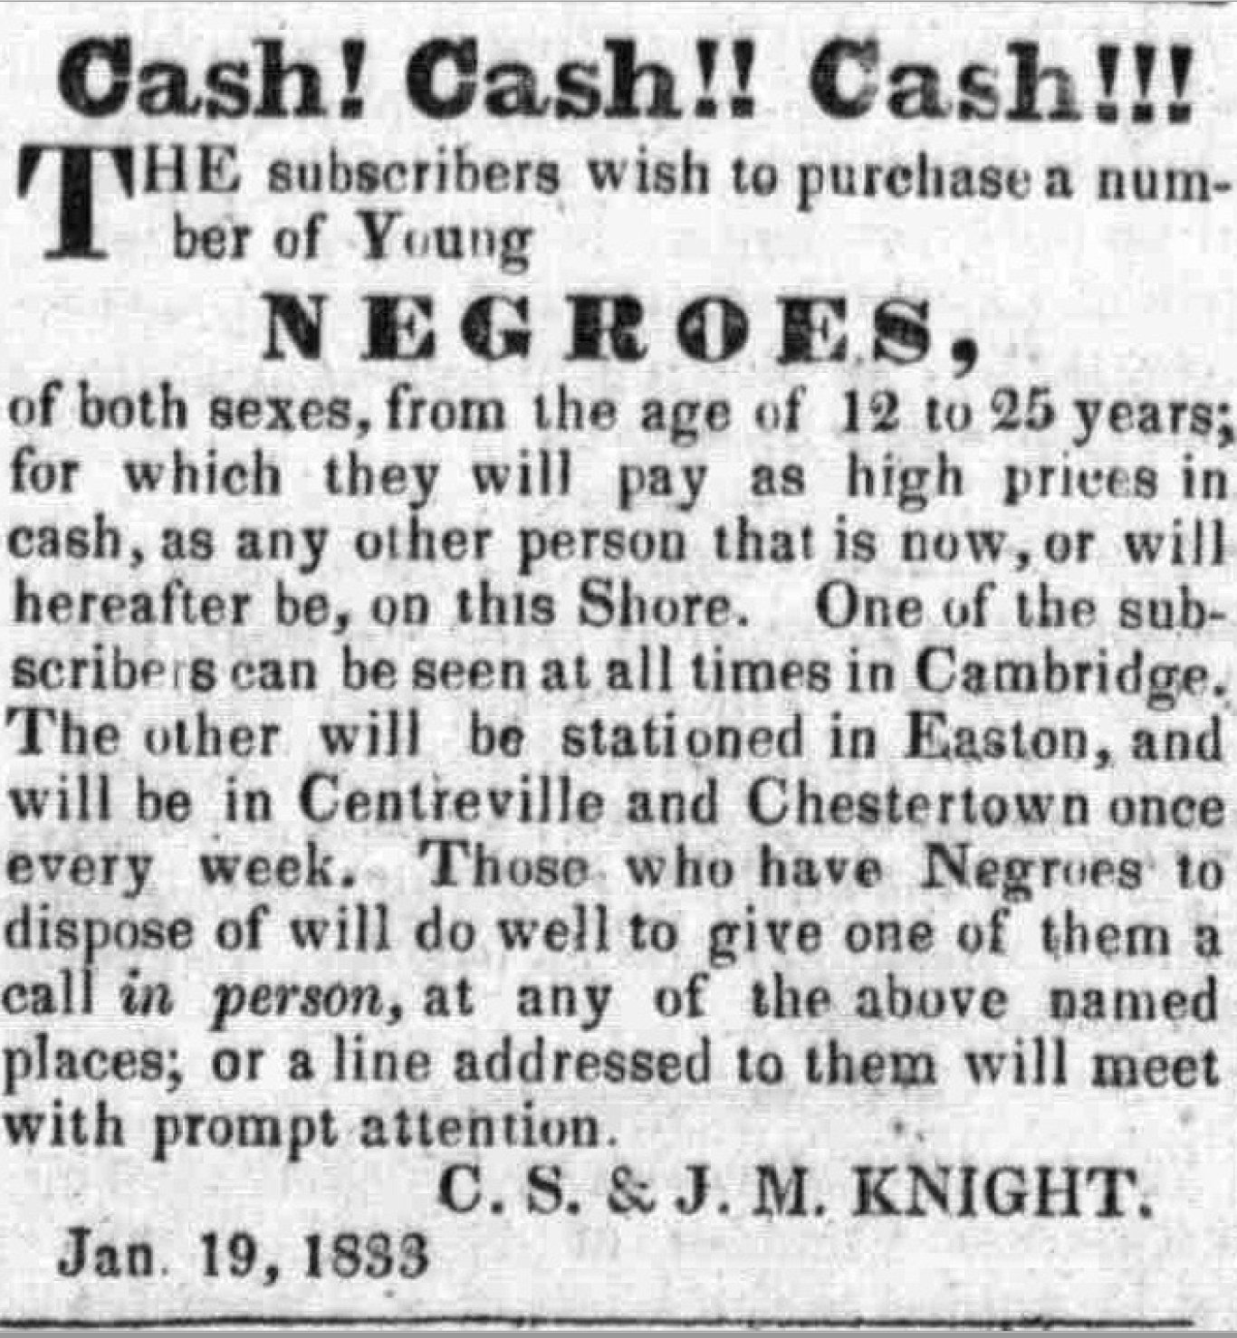
Data: Domestic Traffic Ads
MSA Legacy of Slavery Project (1824 to 1864)
“[D]omestic traffic is defined as the interstate and intrastate trade of enslaved men, women, women and children. Similar to runaway ads and committal notices, domestic traffic ads were a means of communicating to the general public the subscriber’s desire to buy or sell a slave(s). Ads could be placed by private slave dealers and agents, gentry in need of domestic help, yeomen in need of extra field hands, or a public sale of an estate by the orphan’s court.” MSA

Slide 34
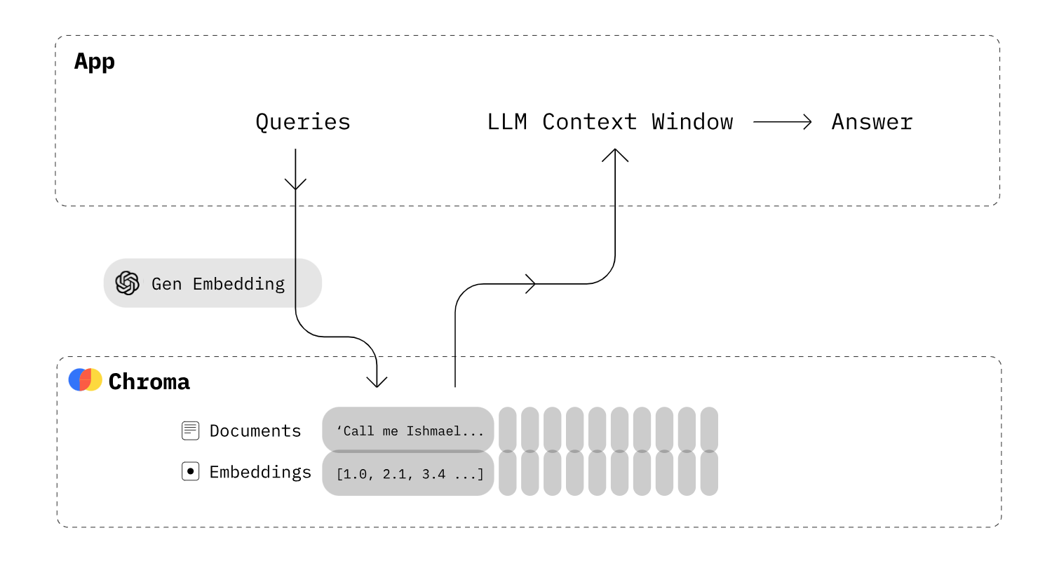
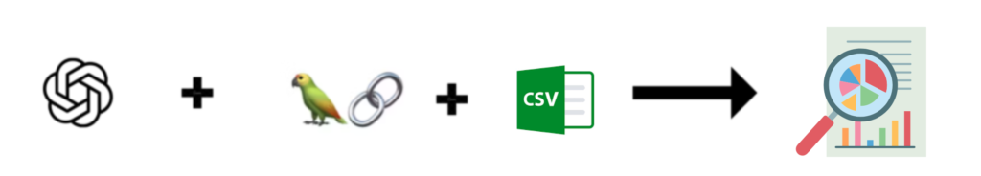

DTA and LaaS/Gen AI Pilot Project (2023)
Use DTA with LLM to create a Contextualized AI Chatbot (RQ1)
Perform Data Analysis on DTA dataset & Comparative Analysis (RQ2)
LangChain CSV Agent
VS.
PILOT FINDINGS:
DTA content was not AI-ready and needed significant pre-processing to lend itself to generative AI.
GPT models need to understand the context of the DTA collection and be further trained.
GPT models have parameters that allow for some control of trustworthiness.
GPT models seem to be able to duplicate some of the level of analysis seen in non-AI exploratory case studies.
.
Reference: “Conversing with the Past: Re-examining the Legacy of Slavery in Domestic Traffic Newspaper Advertisements with OpenAI's GPT3 LLM”. R. Kumar Gnanasekaran, C. E. Haley, and R. Marciano. In UCL Press/AEOLIAN edited collection: Artificial Intelligence for Cultural Heritage Organisations across the AtlanticTo be published in 2024.
Notes:
Re-format this to put in

Slide 35
Case Study 4:
Harnessing Gen AI to Support Exploration and Discovery in Library and Archival Collections
AN adventure on the frontier of innovation

Slide 36
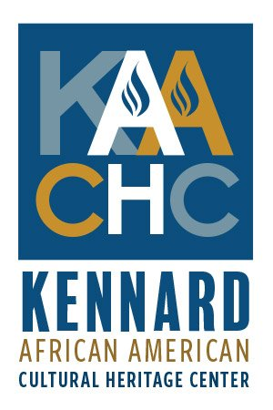
Project Overview
Research Methodology: Exploratory Case-Study with Stakeholder Participation
Funding from the IMLS National Leadership Grant for Libraries (NLG-L) program (July 2024)
NLG-L Goal 3 & Objective 3.2: ‘Improve the ability of libraries and archives to provide broad access to and use of information and collections’ & ‘Support innovative approaches to digital collection management.’
Community Partners/Collaborators:
  MSA/LoS
Research Questions | Research Methods
(RQ1) How should we further curate library and archival collections to make them AI-ready? | Research collection curation techniques and AI-readiness to support generative AI work and refine GPT models to understand a collection’s context.
(RQ2) How can we compare GPT models with traditional, non-AI exploratory data analysis models? | Interrogate the DTA dataset using traditional, non-AI approaches for comparison with GPT model results.
(RQ3) How can we incorporate socio-technical considerations to promote trustworthiness and mitigate potential bias arising from the use of GPT models with library and archival collections? | Engage domain experts and community members in GPT model design and evaluation via surveys and focus groups; and incorporate their contextual input for data preparation, prompt engineering, and model training.
  Project Team
  RQ1:Richard Marciano (PI): Professor
  Rajesh Kumar Gnanasekaran: Doctoral Candidate, iSchool, U. of Maryland, campus IT director
  RQ2: Mark Conrad: Digital Archivist, AI-Collaboratory (formerly with the U.S. National Archives)
  RQ3: Lori Perine: AIC Research Fellow & former Associate Researcher in Trustworthy AI at the National Institute of Standards and Technology (NIST).

Slide 37
Data: Domestic Traffic Ads
MSA Legacy of Slavery Project (1824 to 1864)
“[D]omestic traffic is defined as the interstate and intrastate trade of enslaved men, women, women and children. Similar to runaway ads and committal notices, domestic traffic ads were a means of communicating to the general public the subscriber’s desire to buy or sell a slave(s). Ads could be placed by private slave dealers and agents, gentry in need of domestic help, yeomen in need of extra field hands, or a public sale of an estate by the orphan’s court.” MSA

Slide 38
Incorporating a Human-Centered Approach For AI-Ready Data
RQ3 - How can we incorporate socio-technical considerations to promote trustworthiness and mitigate potential bias arising from the use of GPT models with library and archival collections?
  Involve user communities throughout design and development pipeline
  Capture user communities’ expectations, concepts, relationships concerning the archival collection and use of gen AI
  Incorporate feedback through regular workshops (human-human)
  Implement feedback receiving mechanisms from the chatbot (machine-human)
  Implement solutions and guardrails in place to address ethics, privacy, and cultural sensitivity
Stakeholder Participation
Pre-processing
Context
Trustworthiness
Quality * Access* Documentation

Slide 39
Planned Workflow (1)
Phase 1: GPT Selection & Focus Group Input for Model Design
Capture user expectations of usability and benefits; establish baselines for risks or vulnerabilities (e.g. racial or gender bias, historical or cultural inaccuracies, privacy, etc.) ➔ ONTOLOGY DEVELOPMENT/SPECIFICATION
User/User Role
User Expectations
Use Case
Contextual Relevance
Anticipated Benefits
Risks/Vulnerabilities
Usability
Accesibility
Interpretability

Slide 40
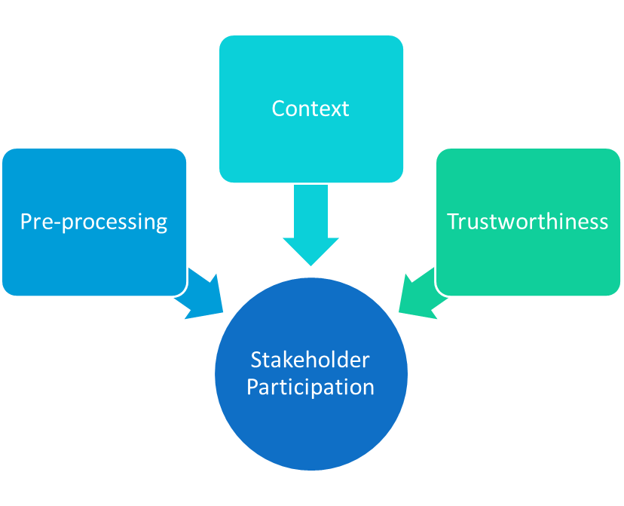
Planned Workflow(2)
Phase 2: – Data Preparation & Model Training
Explore operationalization of focus group expectations and concerns as metadata, features, or functionality to be used in the initial data preparation and/or model training. ➔METADATA SPECIFICATION & USE IN PRE-PROCESSING FOR AI-READINESS
Metadata added during pilot (record)
  Terms of Service,
  Trade Reason
  Features
  Terms of Sale
  Owner
  Optical Character Recognition (OCR) text of each DTA ad image.
Examples of potential metadata developed through stakeholder participation (context/use/trustworthiness focus)
  Metadata for specific use cases (e.g. historical research, K-12 education, higher education, look-up services in libraries or archives, interactive cultural heritage displays in museums, personal and professional genealogy, etc)
  Historical contextual information
  Labels reflecting evolution of knowledge
  Culturally aware labels
  Labels reflecting user sensitivities or risk tolerances

Slide 41
Planned Workflow (3)
Phase 4: GPT Performance Analysis & Re-tuning
Targeted adaptation and retuning with respect to data annotation, metadata, model features, and model functionality, based on stakeholder feedback ➔ REVISED METADATA FOR DATA PROCESSING & MODEL RE-TUNING
Phase 5: Focus Group Working Meeting II
Real-time evaluation of usability, contextual accuracy, bias mitigation, and use case relevance; identify technical and governance needs; areas for future research. ➔ EVALUATION: PARTICIPATORY APPROACH/SPECIFICATION/TECHNICAL
Phase 3: Focus Group Working Meeting
Exploring and evaluating the usability, contextual accuracy, cultural bias, and use case relevance of the chatbot➔ REFINE ONTOLOGY & METADATA SPECIFICATION

Slide 42
Status/Opportunities/Challenges
Status: Funding announced July 2024; Start date September 1
Opportunities
  “Strengthen the ability of libraries and archives to serve the public and research communities by unlocking new dimensions of access, discovery, and understanding within their collections.”
  Support FAIR (Findable, Accessible, Interoperable, and Reusable) principles and reproducible computational research (RCR)
  Prototype participatory methods that may have more general application (the broader AI community can learn from library/archive practices)
  Contribute to generalizing use of ontologies that incorporate stakeholder participation
Challenges
  Adopting/adapting methods for human-human along with human-tech feedback
  Operationalizing stakeholder feedback in data processing and/or model functionality – limitations? conceptual integrity?
  Potential complexity and contradiction in stakeholder input
  Misuse of GenAI to obscure the cultural record

Slide 43
Upcoming Presentations/Conferences
Program Committee Member, 9th Computational Archival Science (CAS) Workshop, December 2024, Washington, DC.
Funding Acknowledgements
2019-2020 AHRC Research Networking for UK-US Collaborations in Digital Scholarship
in Cultural Institutions called “International Research Collaboration Network in Computational Archival Science (iRCN-CAS)”, with KCL, TNA and MSA)
2020-2022 IMLS Laura Bush 21st Century Librarian Program: “Piloting an Online Collaborative Network for Integrating Computational Thinking into Library and Archival Education
and Practice.”
IMLS Laura Bush 21st Century Librarian (LB21) Implementation Grant: $400K, Aug. 1, 2022-Jul. 31, 2024. “Launching the TALENT Network to Promote the Training of Archival & Library Educators w. iNnovative Technologies”

Slide 44



Comments, discussion, and questions are welcome.
Contact Information:
Lori Perine Lperine@umd.edu
https://www.linkedin.com/in/lperine/

